Slide 1
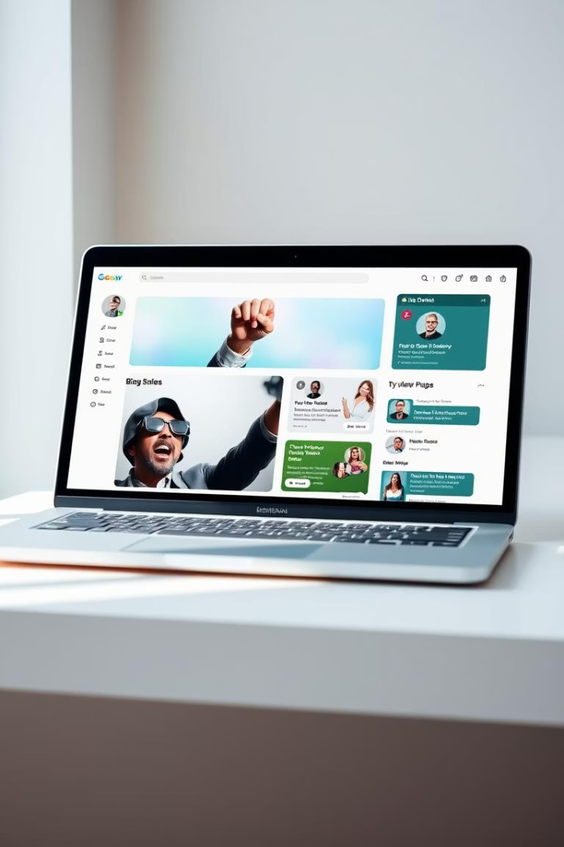

PostScribers
A multi-user blog platform with full admin control

Slide 2

User Account Management
User Registration & Login
Password Reset via Gmail
Reset Page Redirection
Simplified process to create and access accounts securely.
Automated emails with reset links improve user convenience.
Users redirected directly to password reset pages for efficiency.

Slide 3
Blog Features
Add, Read, and Search Blogs
Filter Blogs by Interest
Search by Title or Topic
Users easily create and explore diverse blog content.
Custom filters help users focus on topics they love.
Robust search functionality quickly finds relevant posts.

Slide 4
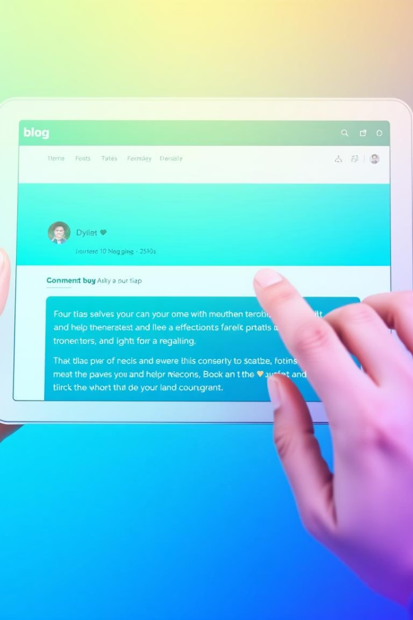
Interaction & Personalization
Comment on Blogs
Edit/Delete Own Blogs
Engage with authors by adding contextual comments.
Control over content with instant editing or removal.
View & Edit Profiles
Personalize profiles to express individual identities.

Slide 5
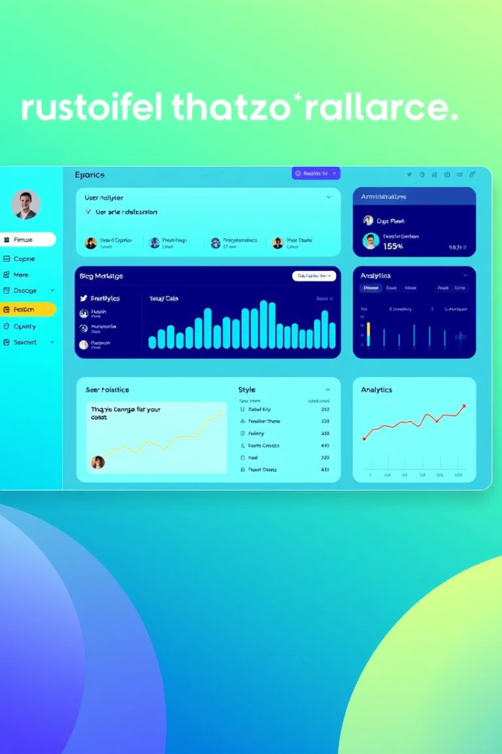



Admin Panel
Superuser Access
Complete control via secure /admin backend interface.
Manage Content & Users
Easy oversight of Users, Blogs, Comments, and Groups.
Roles & Permissions
Modify permissions to tailor user capabilities.

Slide 6



Role Management
Staff
2
Restricted access based on assigned groups.
Superuser
Unrestricted access to all platform features.
1
Groups
3
Create and assign permissions efficiently.

Slide 7


Comment & Blog Moderation
User Profile Management
Edit/Delete Content
Admin panel provides easy profile oversight and updates.
Superuser can manage any comment or blog post seamlessly.

Slide 8
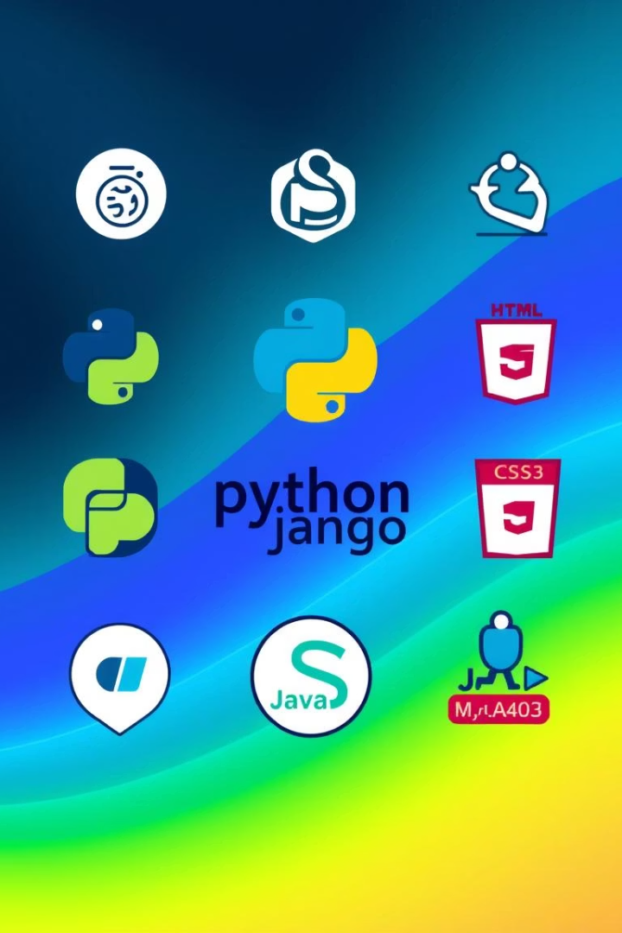
Technologies Used in the Website
Backend: Django (Python)
Frontend: HTML5, CSS3, JavaScript
Database: MySQL
Extras: Admin panel, ORM, Forms, File uploads

Slide 9

Django – Python Web Framework
MVT Architecture
Core Features
Django ORM
Model-View-Template design pattern
URL routing and session handling
Seamless interaction with MySQL database
Built-in admin interface
Authentication system

Slide 10

Frontend Technologies
HTML5
Defines page structure and content
CSS3
Manages styling and responsive layout
JavaScript
Enables client-side interactivity
Django Templates
Renders dynamic content server-side

Slide 11

MySQL – Relational Database
Data Storage
Holds users, posts, comments, and more
Django Integration
Accessed via Django ORM for queries
Powerful Queries
Supports complex relations and transactions
Reliability & Scale
Proven robust and scalable solution

Slide 12
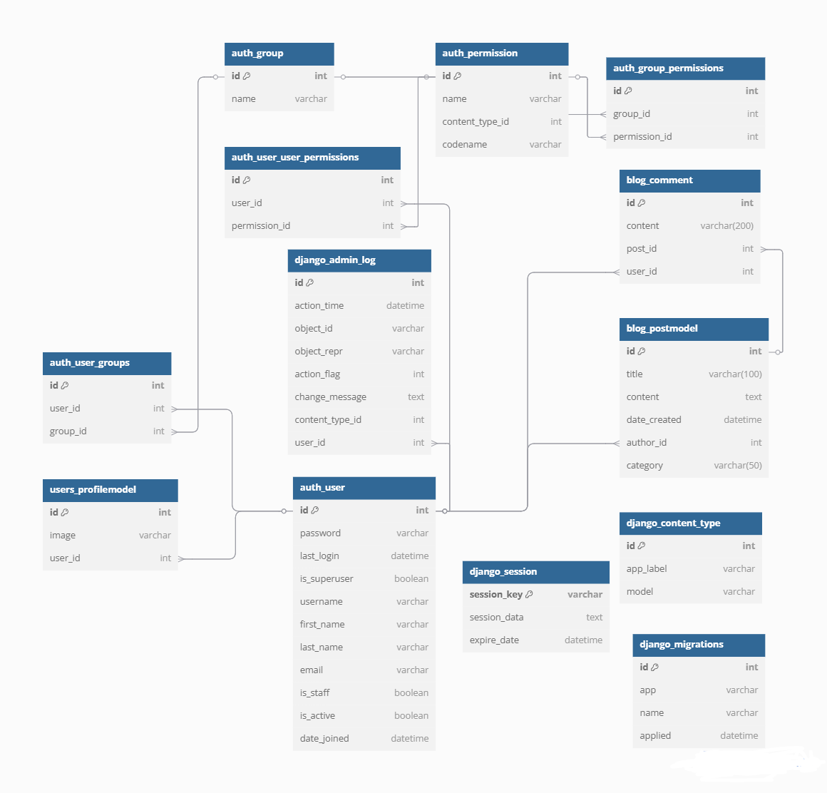
Database Schema Diagram

Slide 13
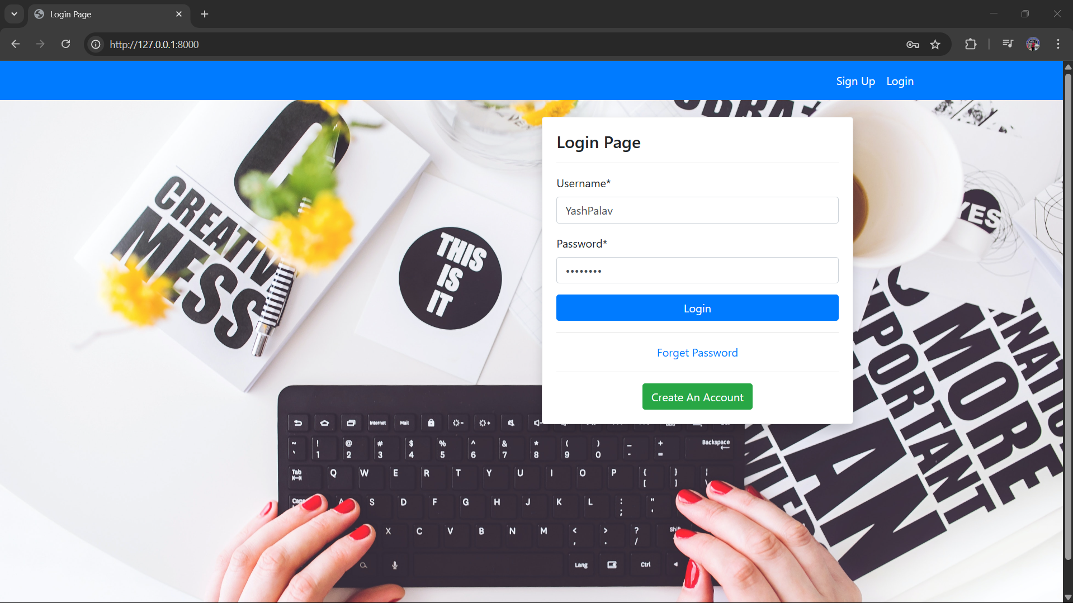
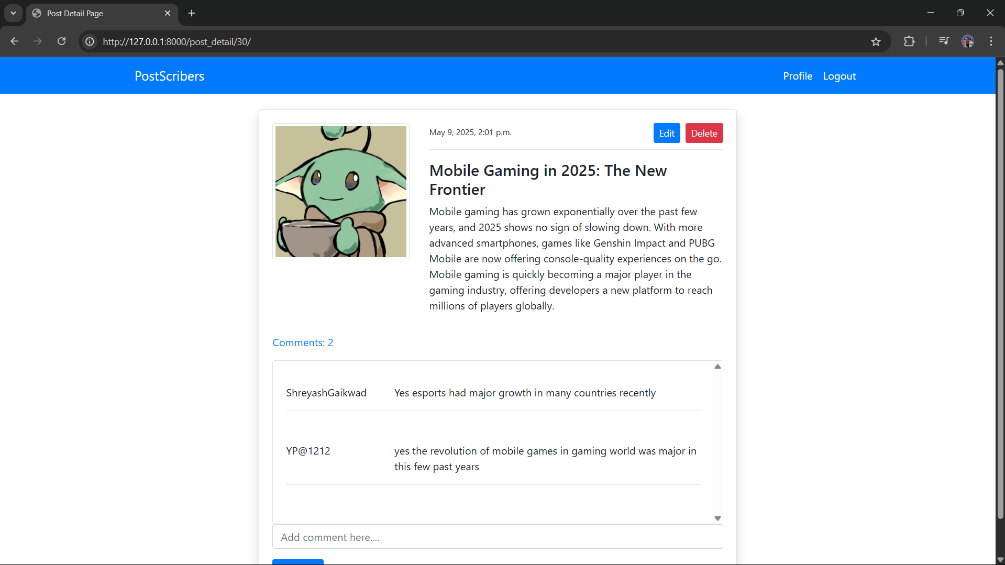
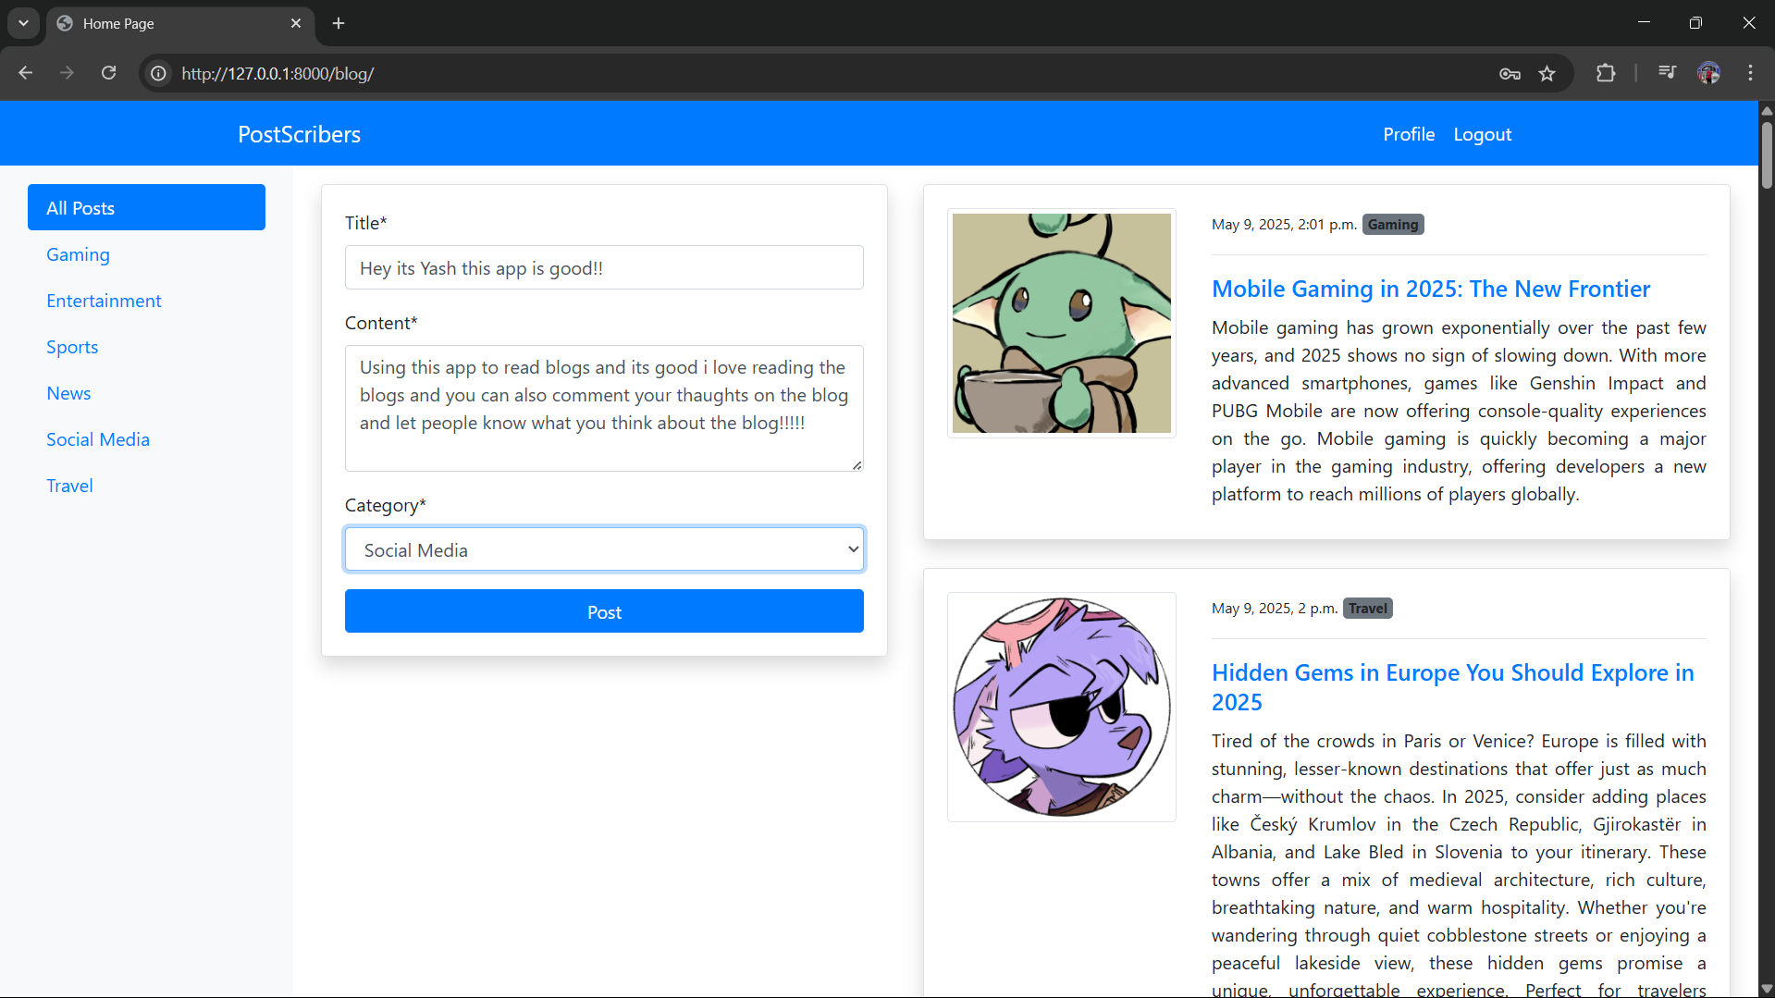
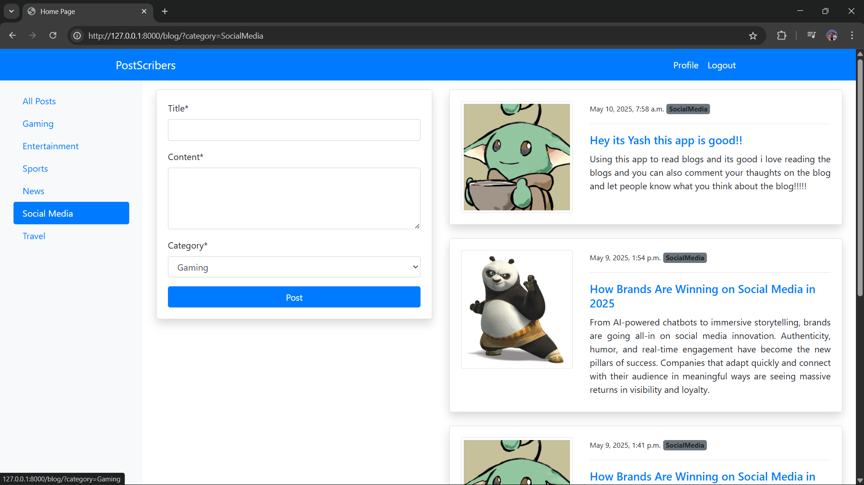
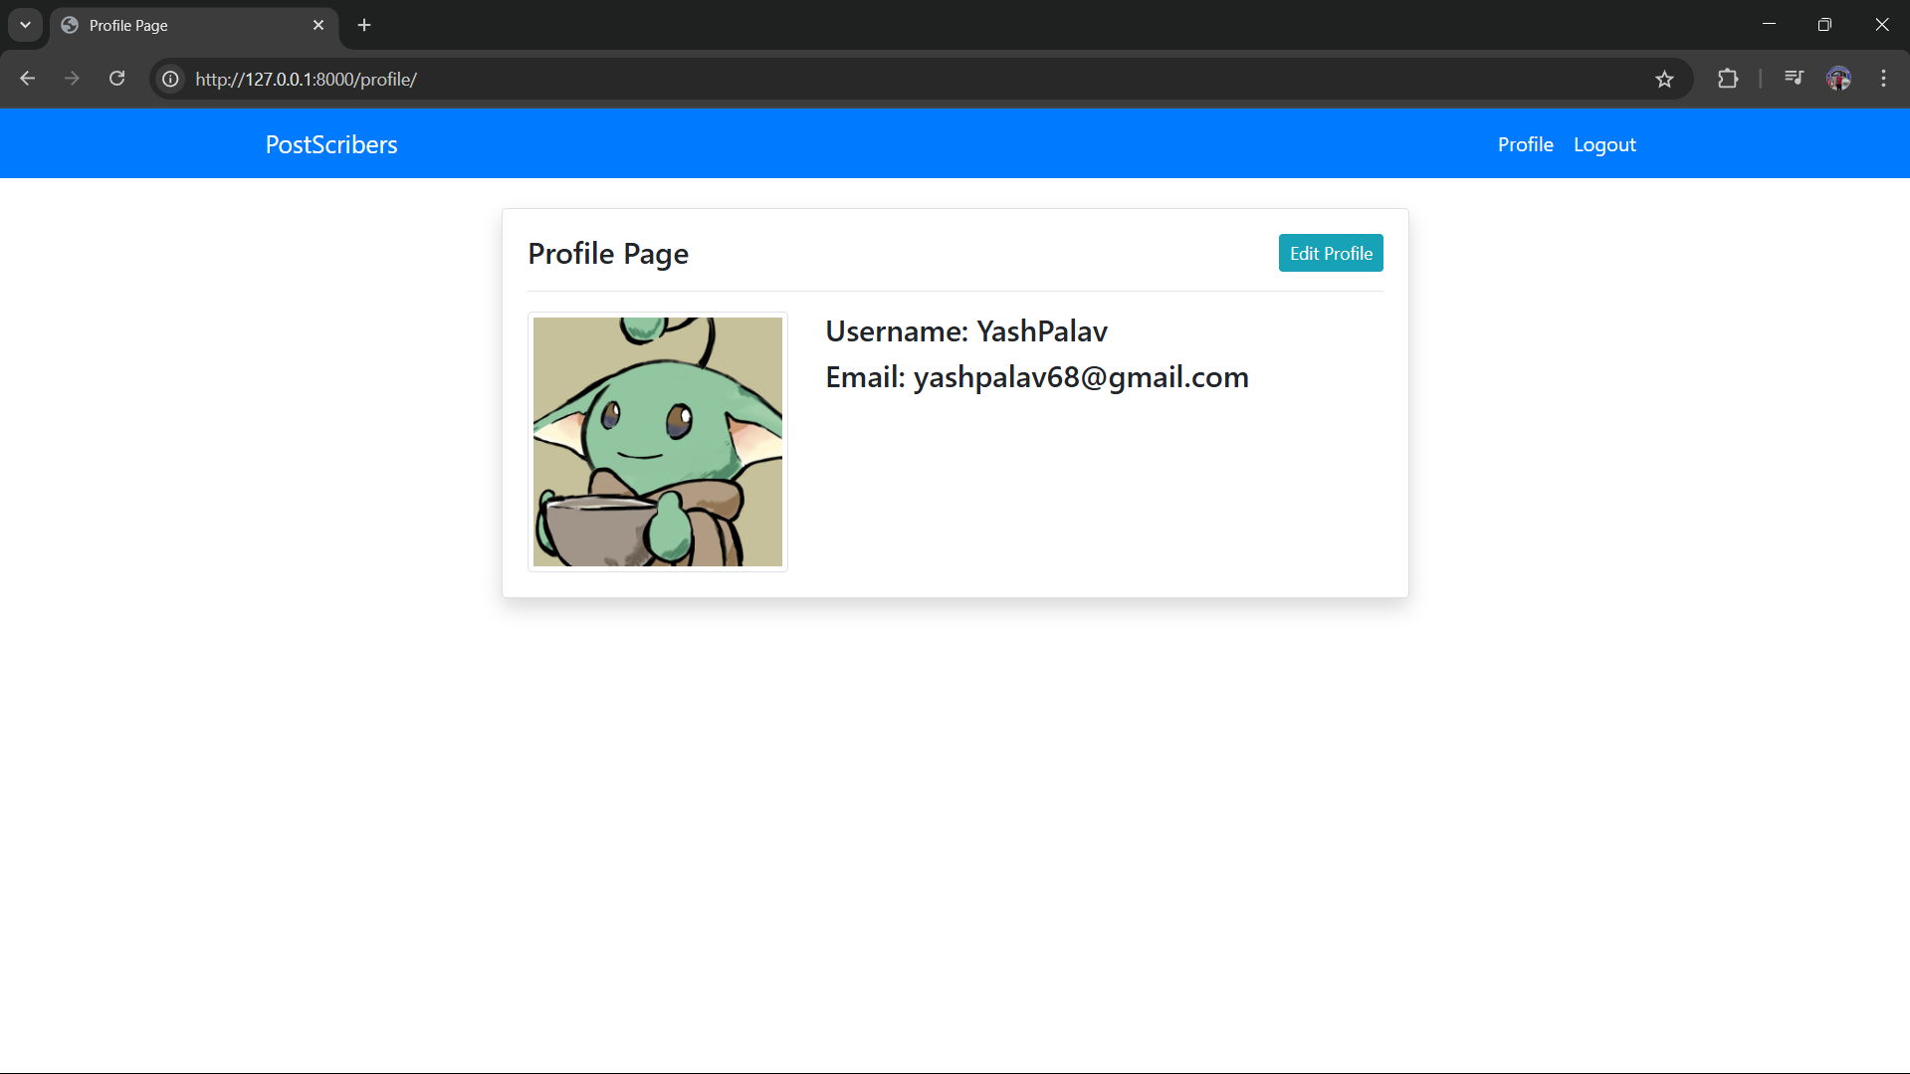
Website Layout Design

Slide 14
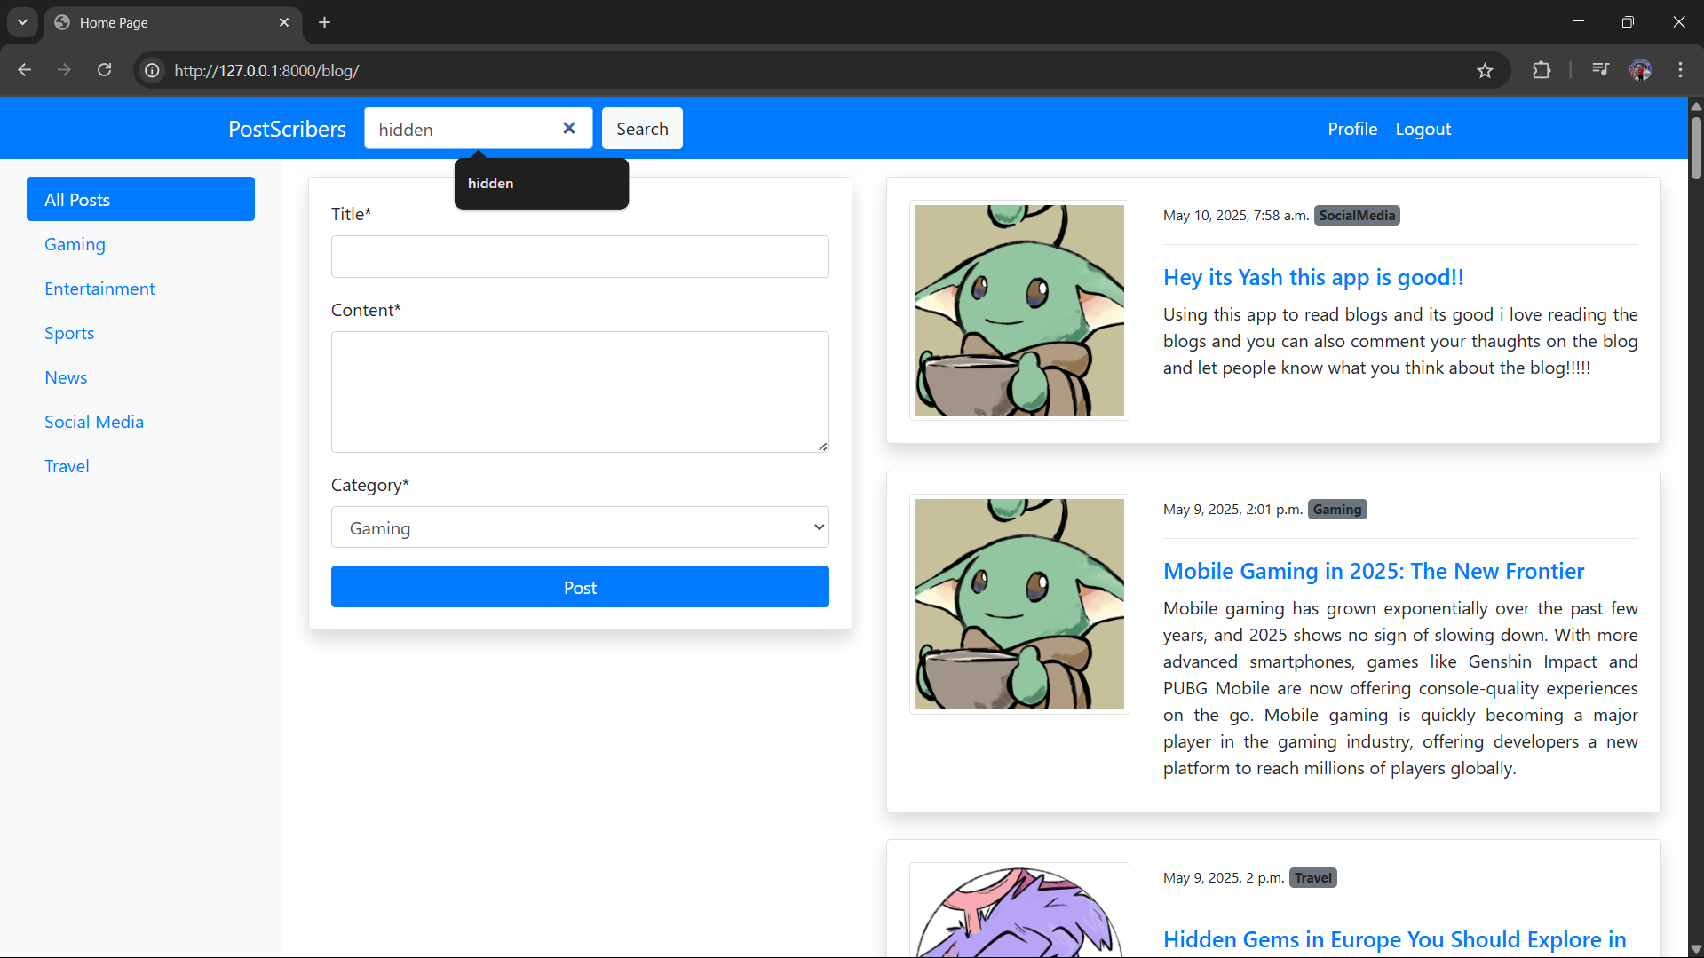
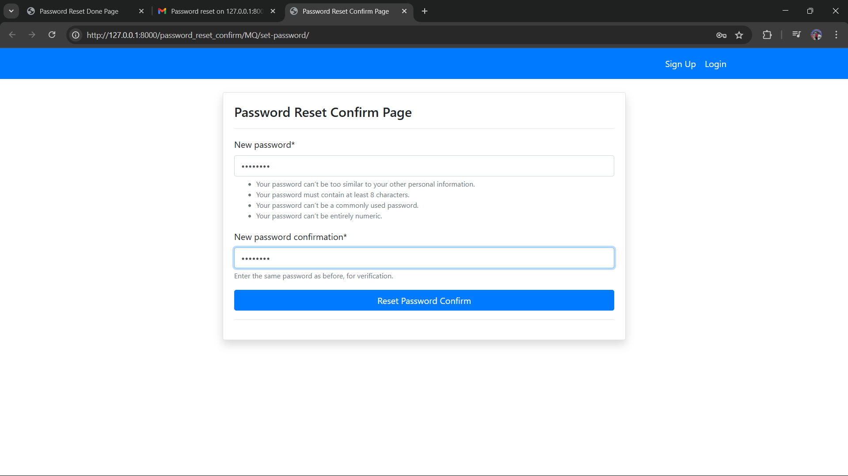
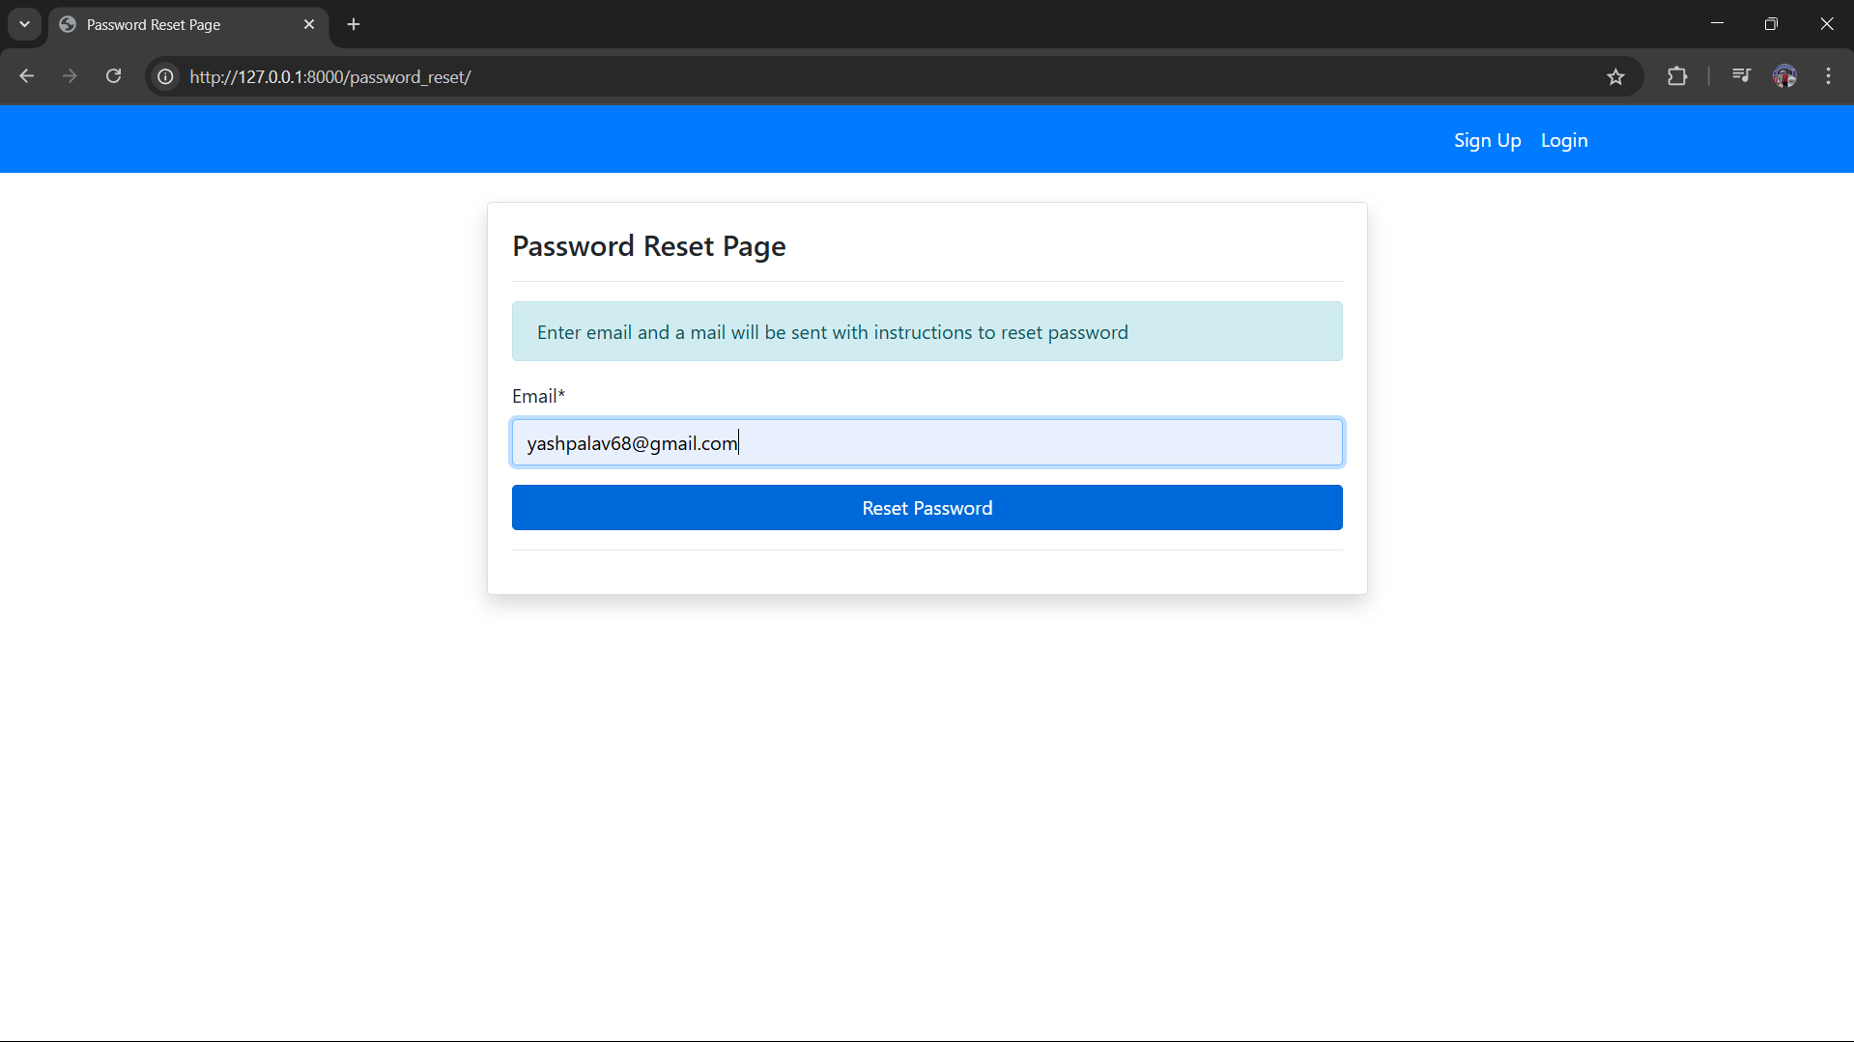
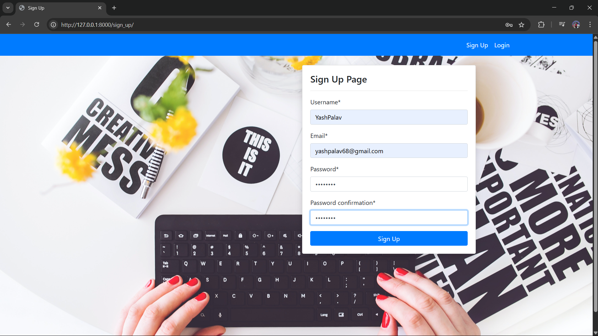

Website Layout Design

Slide 15
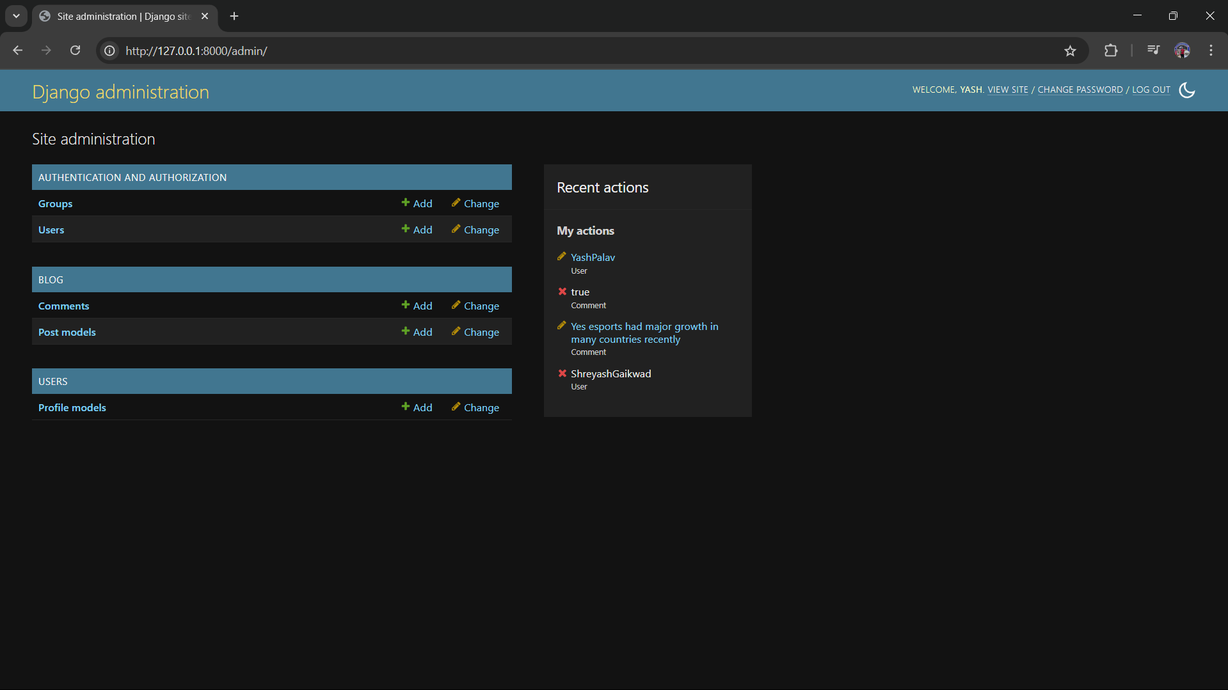
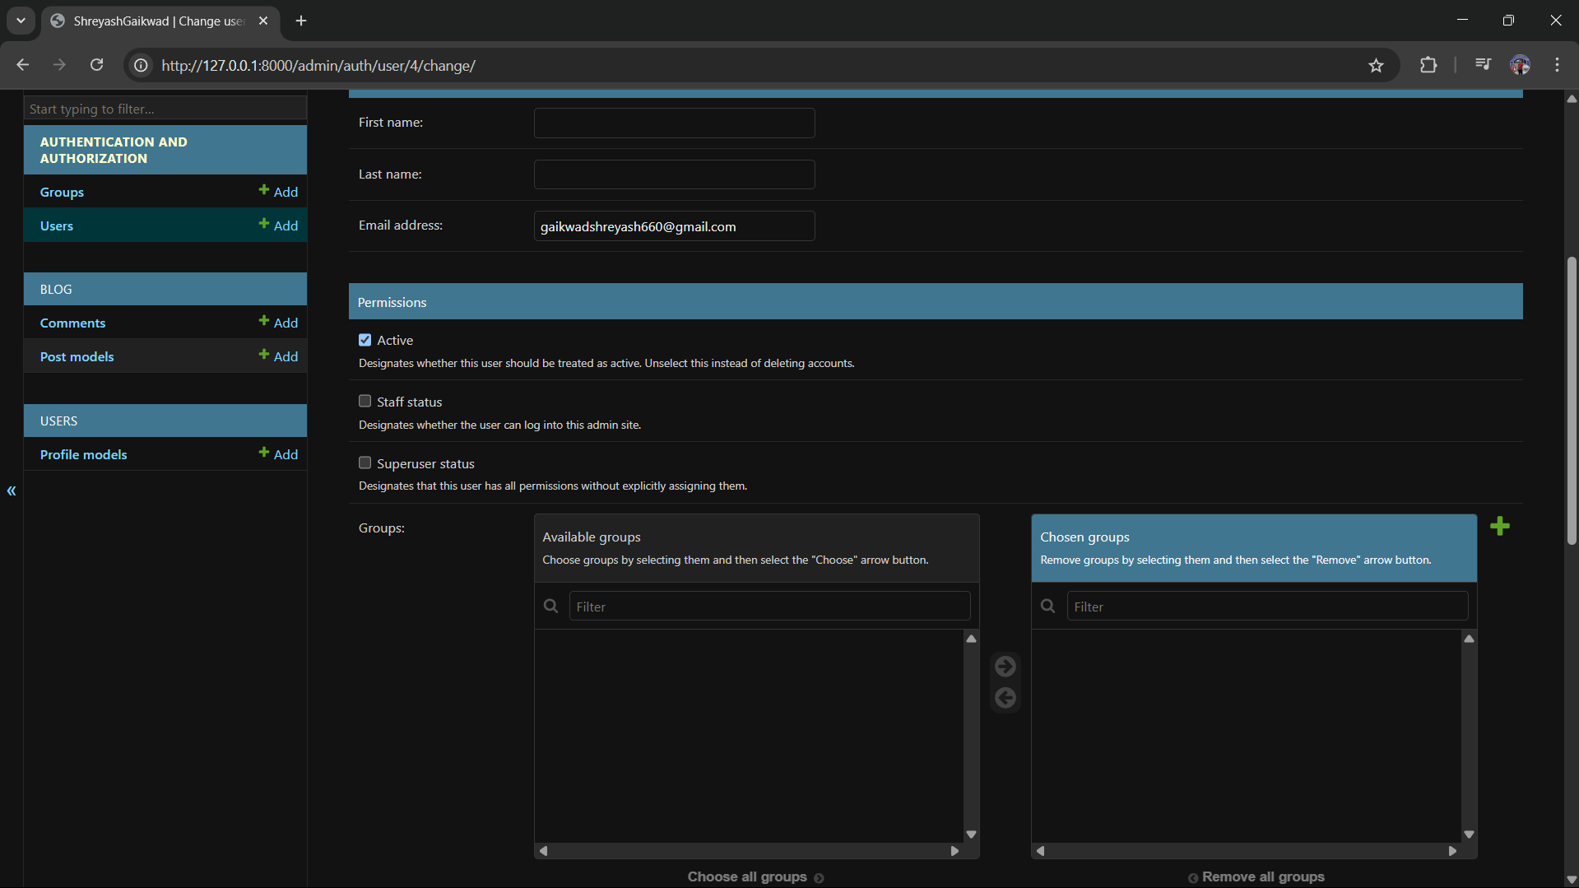
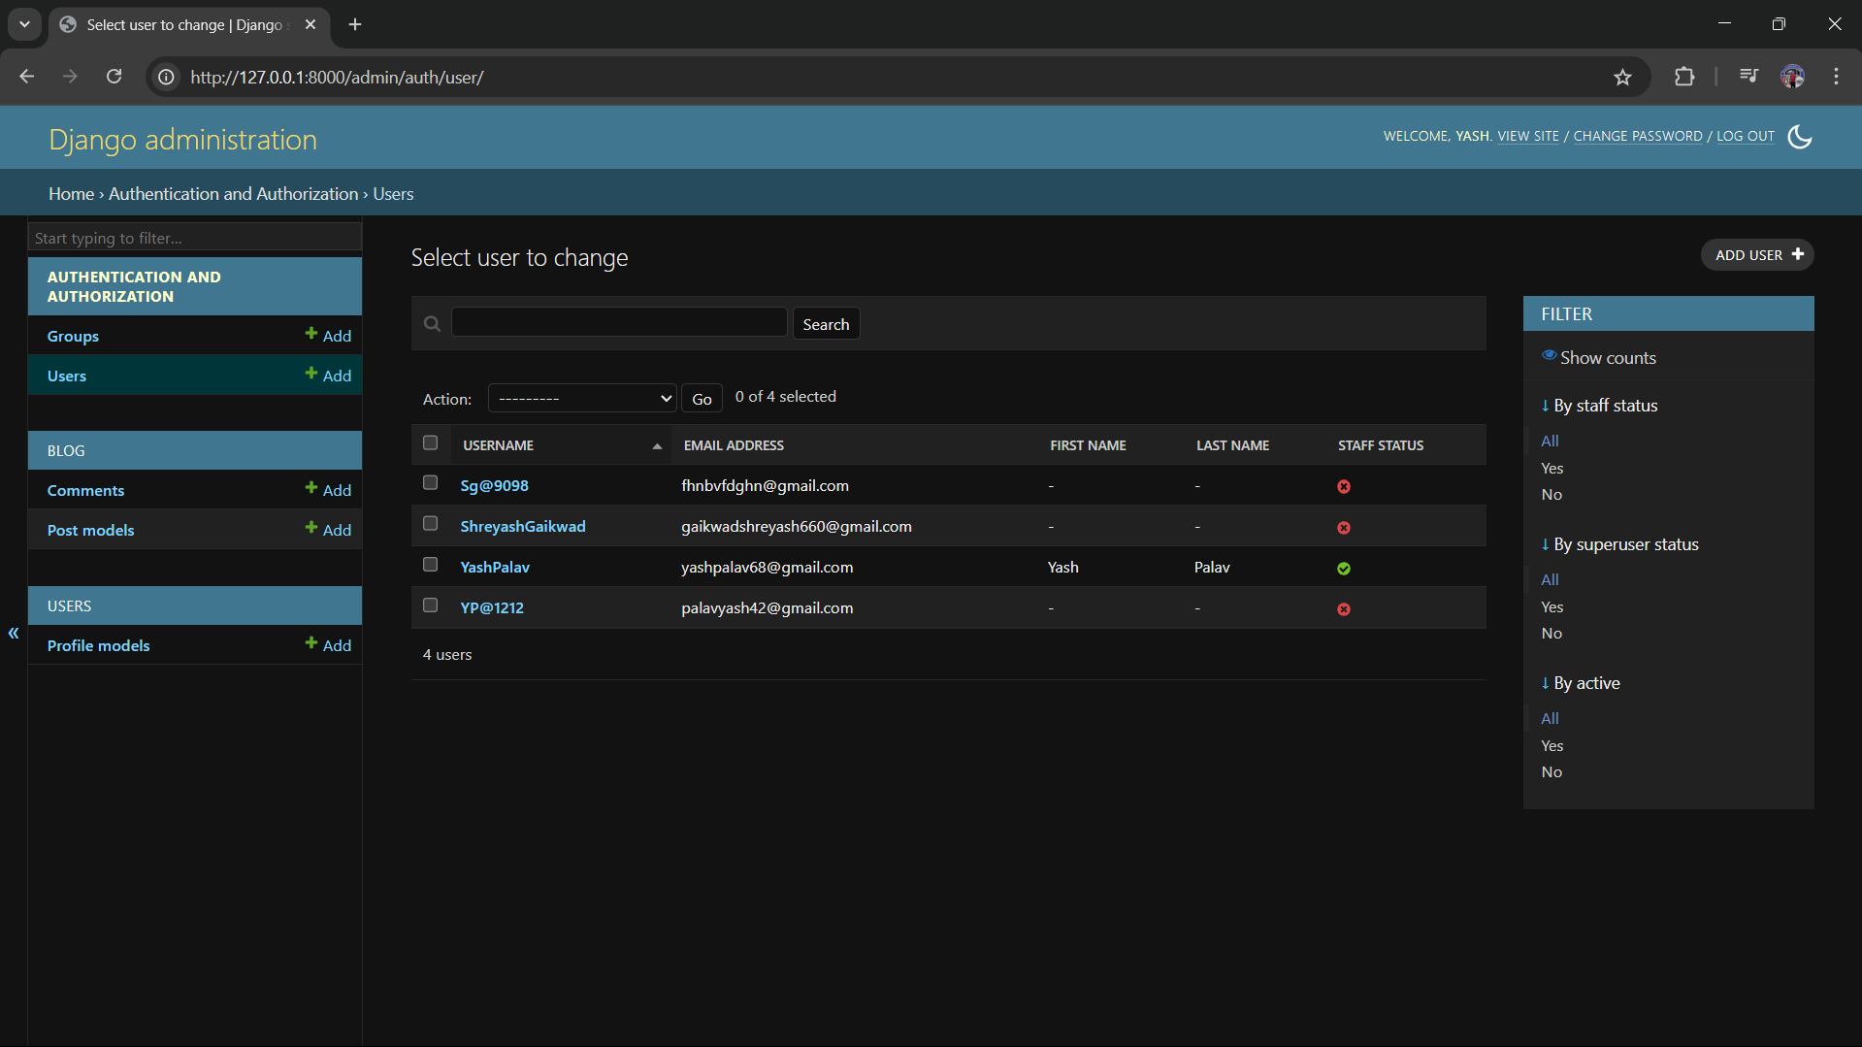
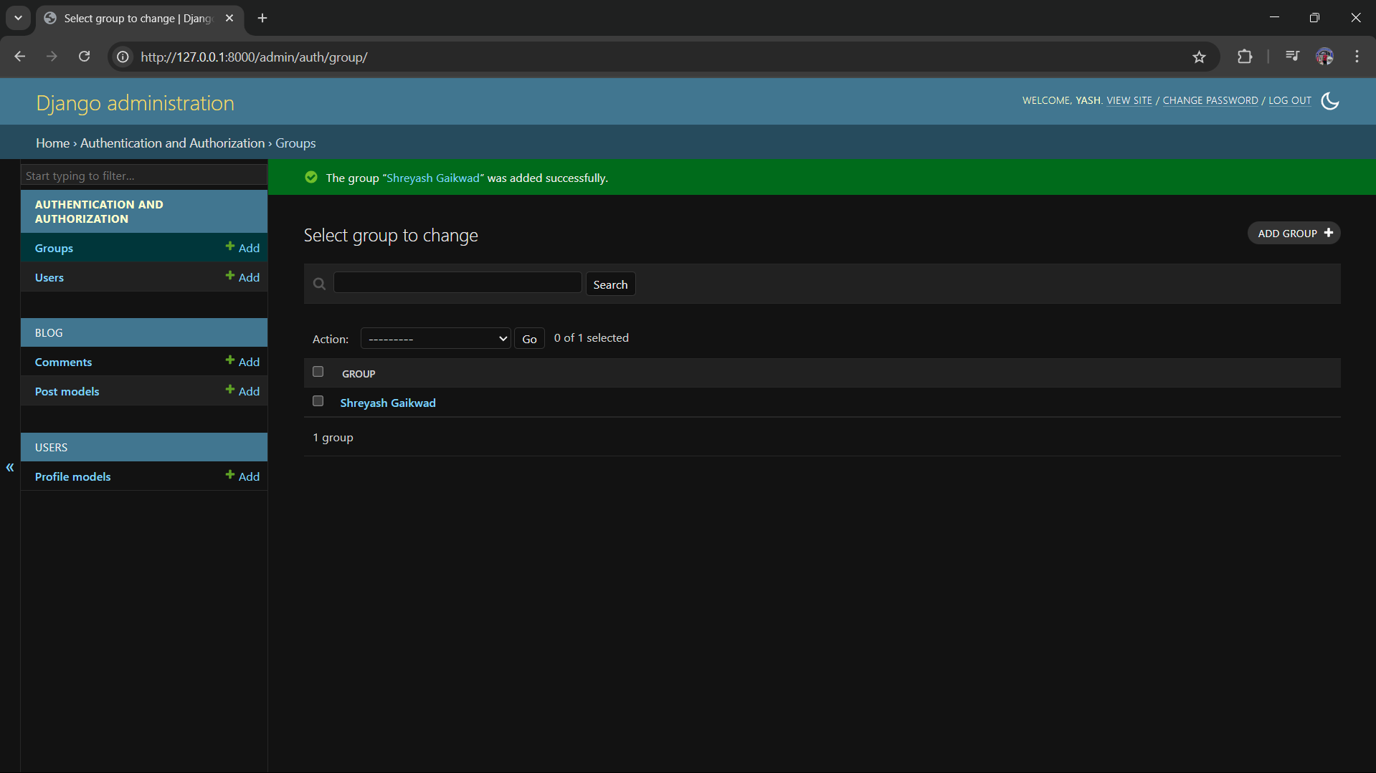
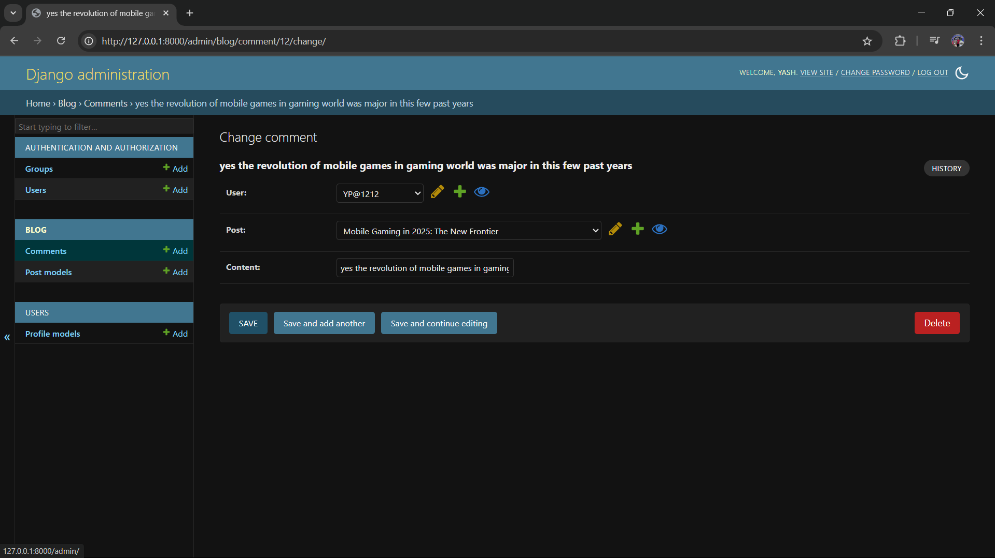
Website Layout Design (Admin Page)

Slide 16
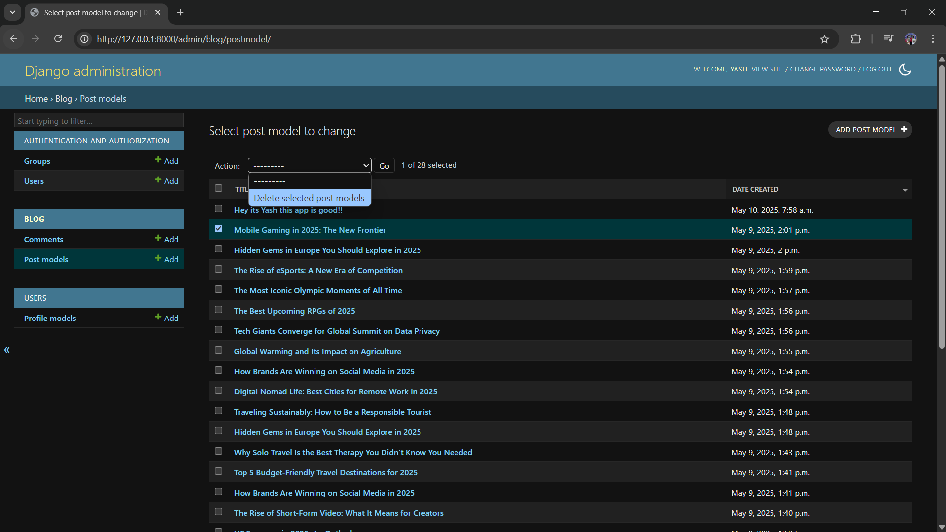
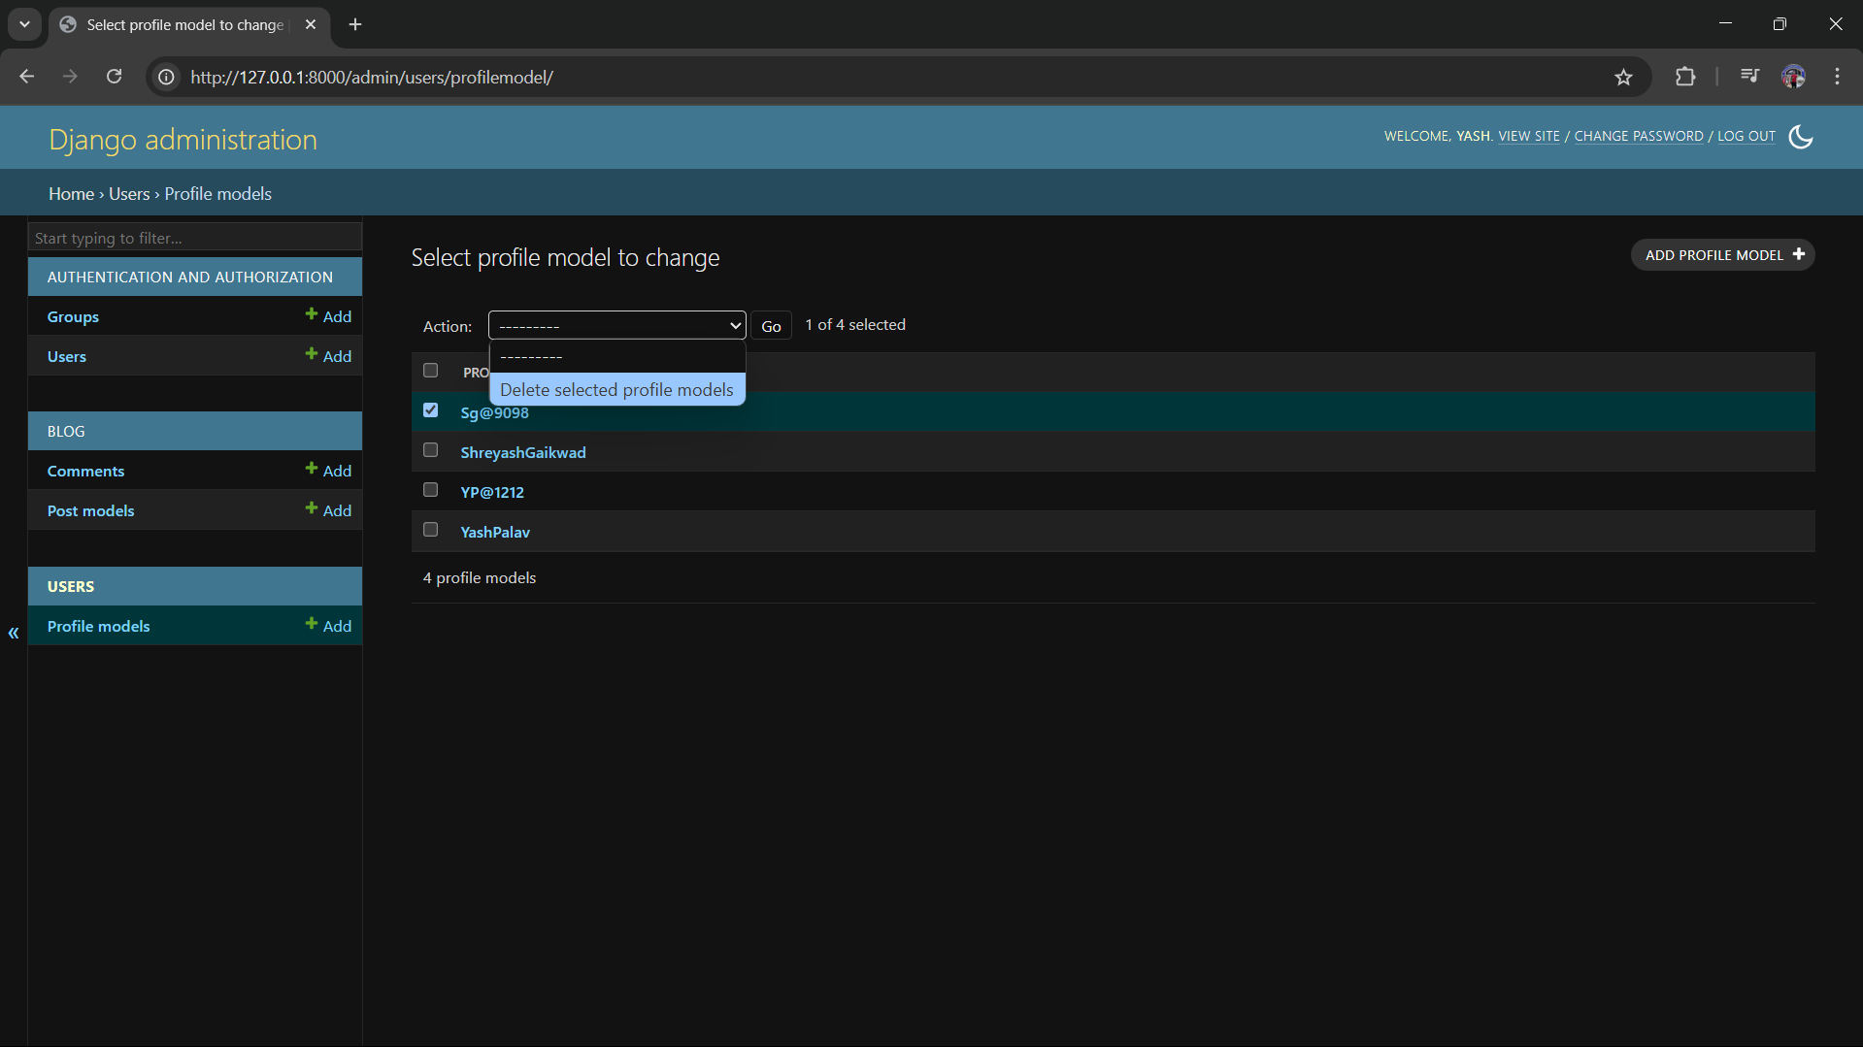
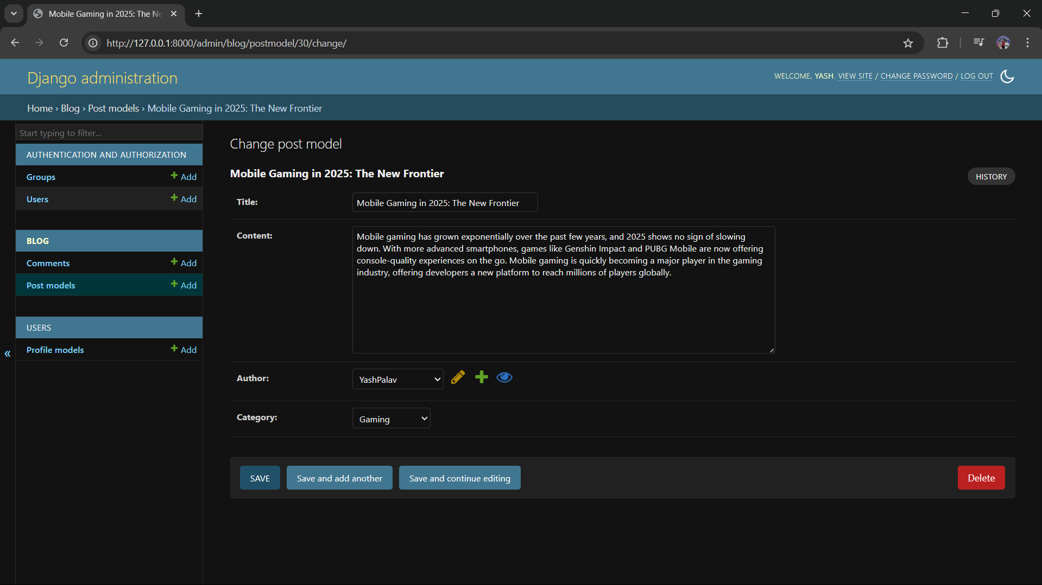
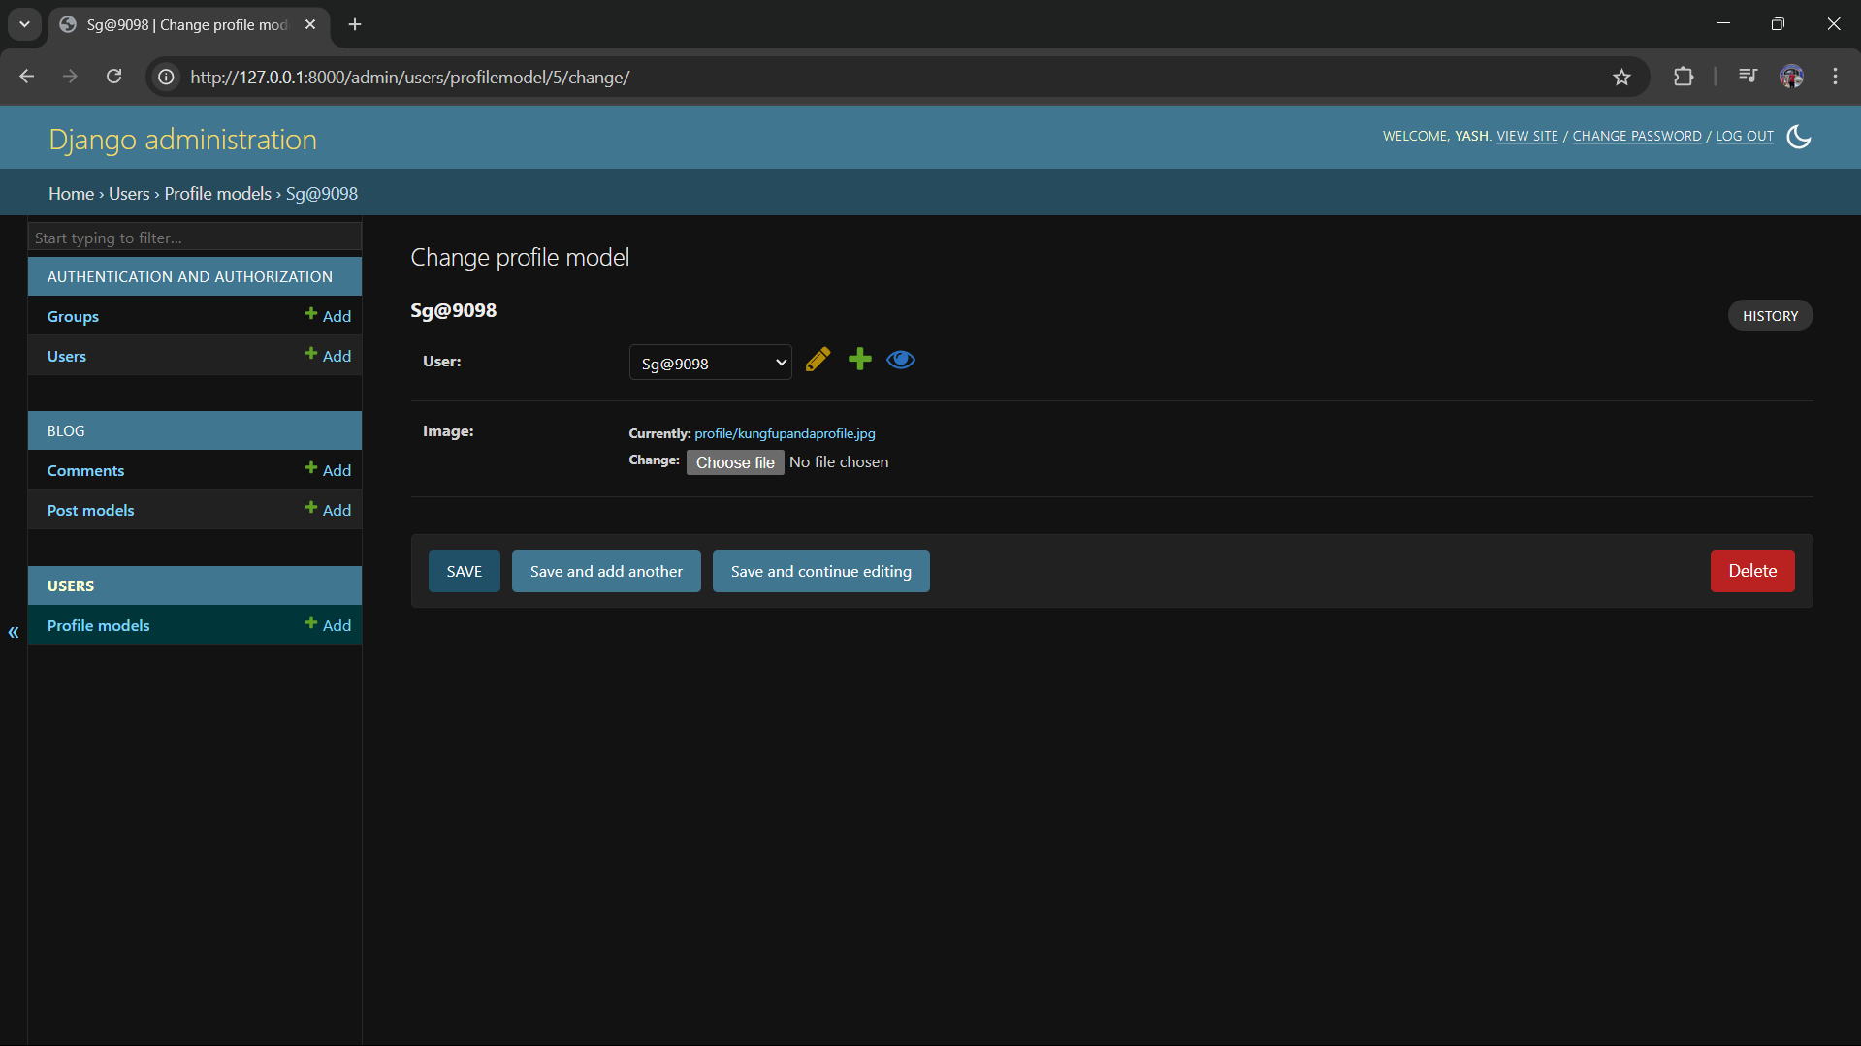
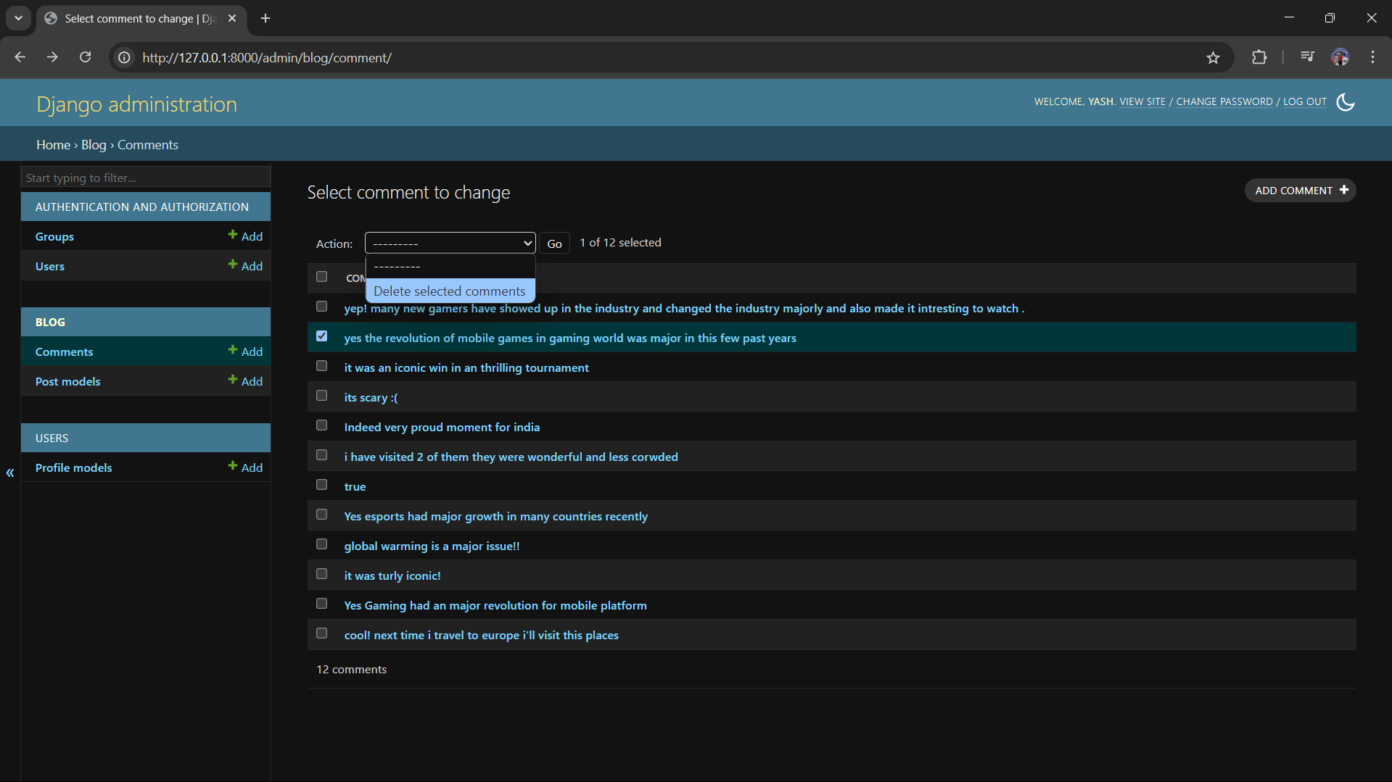
Website Layout Design (Admin Page)

Slide 17
Thank YOU !
For your attention
Conclusion
✅ Website Summary:
• Built using: HTML, CSS, JavaScript
• Purpose: To showcase products and allow users to shop easily
• Key Features: User-friendly interface, responsive design, dynamic content
💡 What I Learned:
• Practical web development skills
• Real-world application of frontend–backend technologies
• Improved problem-solving and debugging
🙏 Thank You for Watching!
Questions? I’m happy to answer!

